Slide 1

Personality Prediction Using Social Media Post
MAEER’s Maharashtra Institute of Technology,Pune
Department of Computer Engineering
Under the guidance of :-
Guide Name
Prof (Mrs) Mamta Bhamare
Student Names and Exam Seat Numbers :-
Jay Naik (71700258G)
Ajinkya Pingale (71700465B)
Manoj Nandha (71700401F)
Akash Misal (71700377K)
2018
‹#›

Slide 2
Motivation
To Understand the personality.
For Recruitmenting the candidate for the proper job description.
To get the relevant information of user for recommendation and Online Marketing
To detect the personality description for consulting services and E-commerce services

Slide 3
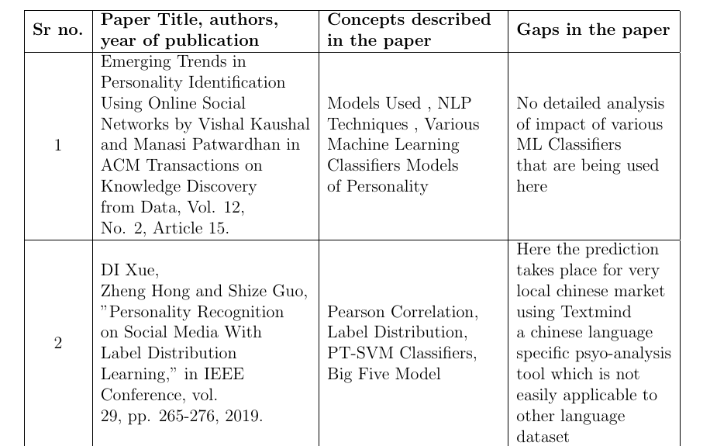
Literature Survey

Slide 4
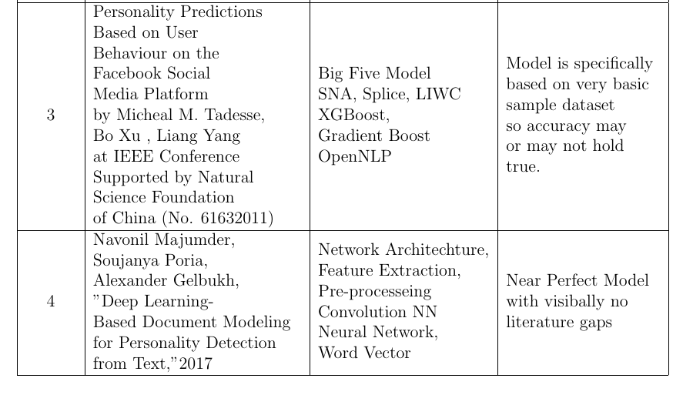
Literature Survey

Slide 5
Problem Statement
One of the Major Platform today to express your emotions , expression , feelings , views about something or about any product is Social Media .
People can put forward their opinion on social media , since active social media user base around world is more than that of billions , it can be used to judge what people think about an issue or product .
People put forth what they feel , therefore their individual post can be judged as a reflection of their personality , but how to judge a personality of a person based on social media post and that too of say large data say thousands , and produce analysis on it .
Therefor the problem statement is to predict personality of a person using his social media posts .

Slide 6
Justifications
Traditionally all the personality detection was done by questionnaire.
When Researchers opted for social media analysis , first they went for traditional baseline methods
Accuracy was limited in this approach
So we used Deep Learning Based Methods to learn from the data
Through Deep Learning methods we could now extract more out of a sentence which wasn’t possible earlier.

Slide 7
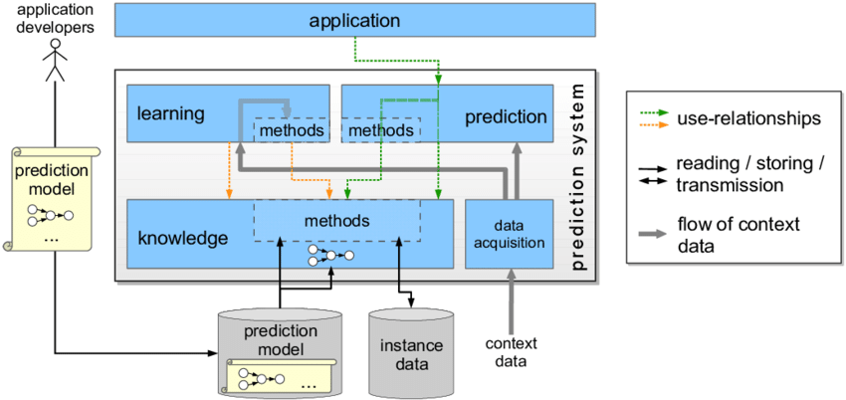
System Architecture

Slide 8
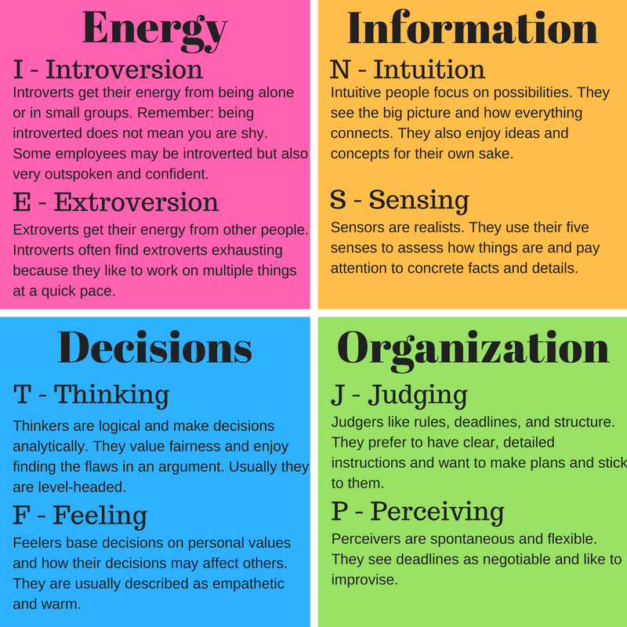
MBTI Model

Slide 9
Based on above 8 qualities 16 traits have been formed -
ISTJ - The Inspector
ISFJ - The Nurturer
INFJ - The Counselor
INTJ - The Mastermind
INTP - The Craftsman
ISFP - The Composer
INFP - The Idealist
INTP - The Thinker
ESTP - The Doer
ESFP - The Performer
ENFP - The Champion

Slide 10
12. ENTP - The Visionary
13 . ESTJ - The Supervisor
14. ESFJ - The Provider
15. ENFJ - The Giver
16. ENTJ - The Commander

Slide 11
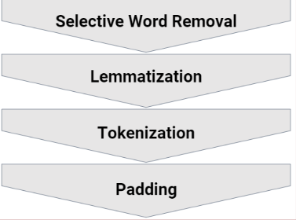
Preprocessing

Slide 12
Selective Word Removal - generalisation , link removal , and avoiding stop words using NLTK
Lemmatization - Stemming , Inflected forms of same words are transformed to the root word.
Tokenization - tokenizing all lemmetized words using keras and numbering according to most common word
Padding - making all the tokenized word of same length by padding extra zeros at the start of smaller words

Slide 13
Modelling
Traditional Modelling
Baseline Methods
Naive Bayers
XGBoost
Support Vector Machine ( SVM)

Slide 14
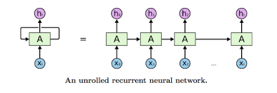
Modelling
Deep Learning Approach
Recurrent Neural Network(RNN)

Slide 15
Mathematical Modelling
For overall system: Let S be the system such that,
S = I, O, FN, SC, FC
Input : - I = Set of all possible inputs
I1 :User Tweets/Posts(Based on their accounts)
Output : - O = Set of all possible outputs
O1 : Personality Traits (INFP,INFJ,INTP,INTJ,ENTP,ENFP,,ISTP,ISFP,ENTJ,ISTJ,ENFJ,ISFJ,ESTP,ESFP,ESFJ,ESTJ)

Slide 16
Function :-
FN1 : Preprocess()
FN2 : wordembedding()
FN3 : model()
Success Condition :-
SC = Set of success cases
SC1 : Exact trait to be recognised

Slide 17
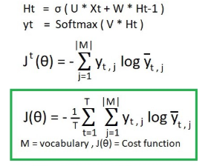
Failure Condition
FC = Set of failure cases
FC1 : Wrong Trait Prediction
To Calculate RNN Output for this we use the formulae for RNN Learning -

Slide 18
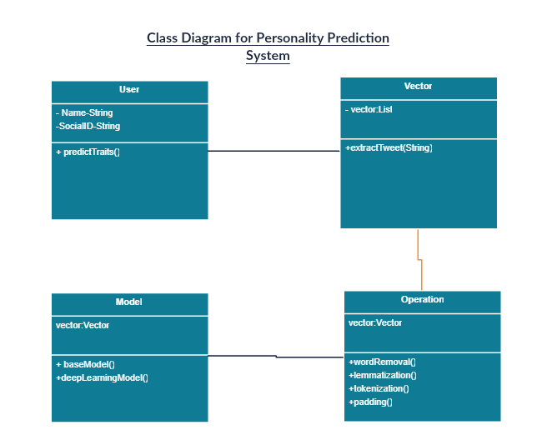
UML Diagrams

Slide 19
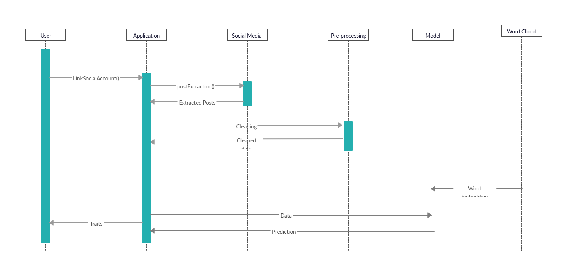

Slide 20
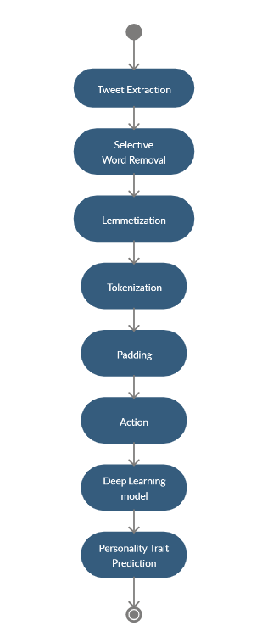
kjlashdjasdlkl
Activity Diagram

Slide 21
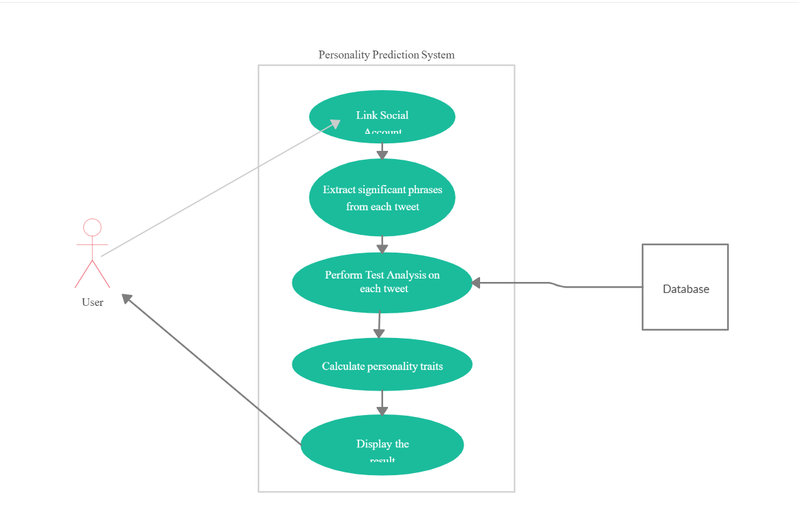

Slide 22
Applications
Recruitment
Counselling
Online Marketing
Corporate
Psychological Profiling
E-Commerce/E-Learning
Recommendation System

Slide 23
Conclusion
Personality identification using social network analysis is a relatively new domain within machine learning research. Since its introduction, however, it has drawn increasing attention by the research community with applications in wide variety of domains. Traditionally the only way personalities were identified was through questionnaire based personality tests that the subjects used to undergo. The surveyed techniques for automatic identification from online social networking
profiles have yielded promising outcomes. Yet, many challenges and opportunities exist. Surveying this topic, we listed some challenges and insights that constitute promising research directions.

Slide 24
References -
Understanding Personality through Social Media - Yilun Wang
Personality Predictions Based on User Behaviour on the Facebook Social Media Platform - MICHAEL M. TADESSE , HONGFEI LIN , Bo Xu and Liang Yang
Personality Recognition on Social Media With Label Distribution Learning - DI Xue , Zheng Hong , Shize Guo , Liang Gao , Lifa Wu
Analyzing and Preventing Bias in Text-based Personal Trait Prediction Algorithm - Shimei Pan and Isil Doga Yakut Killie
Social Media Text - A Source for Personality Prediction - PS Dandanvaar , SR Mangalwade and PM Kulkarni

Slide 25
Thank You

